Slide 1
Application of heavy-tailed distribution using PROC IML, NLMIXED, and SEVERITY
Palash Sharma M.S.
Doctoral Student, Department of Biostatistics
The University of Kansas Medical Center
M.S. in Statistics
University of Nevada, Reno
Passion: applied health data analytics and biostatistics
John keighley, Ph.D.
Assistant Professor, Department of Biostatistics
University of Kansas Medical Center
University of Kansas Cancer Research Center, Kansas Cancer Registry

Slide 2
Outline
Univariate Heavy tailed distribution
Generalized Pareto distribution
Simulation technique
Numerical optimization using PROC NLMIXED
Application using PROC SEVERITY
Cancer patient Data
USA Blackout Data.

Slide 3
Pareto distribution
Univariate Heavy tailed Distribution:

Slide 4
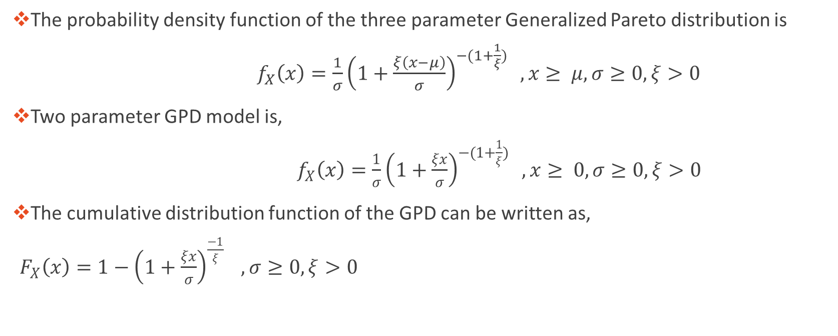
Generalized Pareto distribution
The probability density function of the three parameter Generalized Pareto distribution is
$f_{X}\left(x\right)=\frac{1}{σ}{\left(1+\frac{ξ\left(x−μ\right)}{σ}\right)}^{−(1+\frac{1}{ξ})} ,x≥ μ, σ≥0, ξ>0$
Two parameter GPD model is,
$f_{X}\left(x\right)=\frac{1}{σ}{\left(1+\frac{ξx}{σ}\right)}^{−(1+\frac{1}{ξ})} ,x≥ 0, σ≥0, ξ>0$
The cumulative distribution function of the GPD can be written as,
$F_{X}\left(x\right)=1−{\left(1+\frac{ξx}{σ}\right)}^{\frac{−1}{ξ}} , σ≥0, ξ>0$

Slide 5
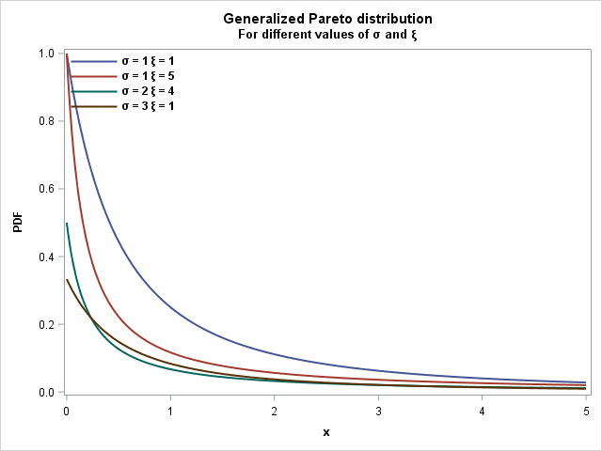
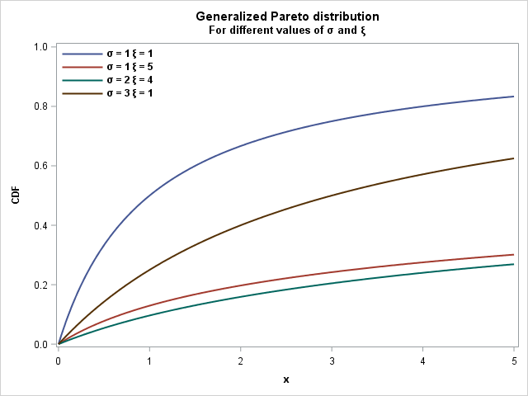
Generalized Pareto distribution

Slide 6

Simulation Technique
Using the probability integral transform theorem
The following closed form expression for generating random variable arising from GPD model.
$$X=F^{−1}\left(U\right)=\frac{σ}{ξ}[ \frac{1}{{\left(1−U\right)}^{ξ}}−1]$$
Where U ~Uni (0,1),

Slide 7
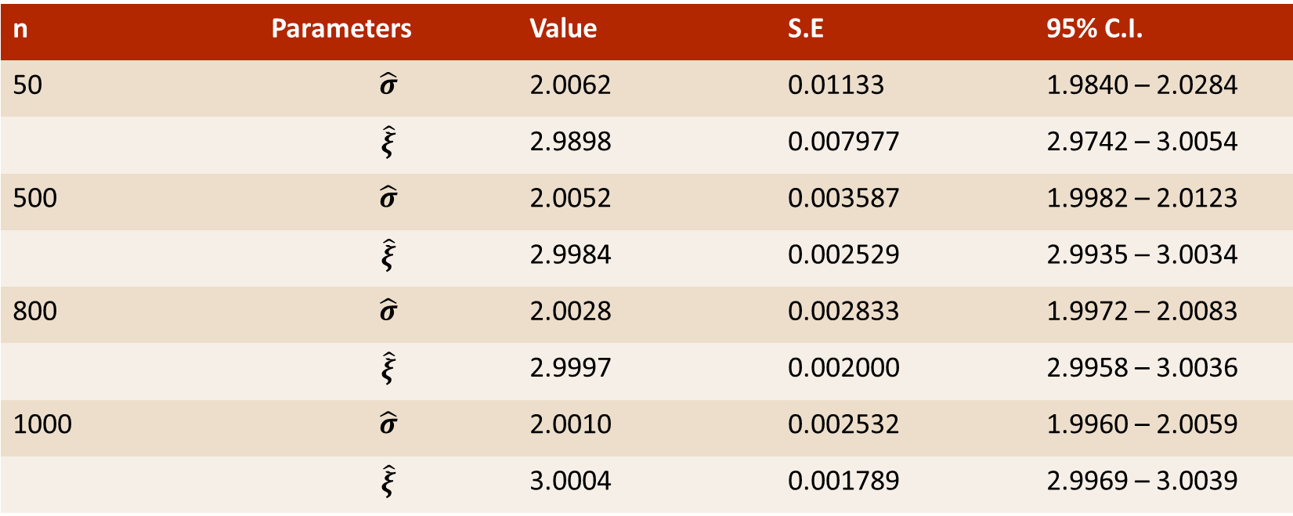

numerical OPTIMIZATION USING PROC NLMIXED Table1: Standard error and estimated parameter when is $σ=2$ and $ξ=3$
n | Parameters | Value | S.E | 95% C.I.
50 | $$\hat{σ}$$ | 2.0062 | 0.01133 | 1.9840 – 2.0284
 | $$\hat{ξ}$$ | 2.9898 | 0.007977 | 2.9742 – 3.0054
500 | $$\hat{σ}$$ | 2.0052 | 0.003587 | 1.9982 – 2.0123
 | $$\hat{ξ}$$ | 2.9984 | 0.002529 | 2.9935 – 3.0034
800 | $$\hat{σ}$$ | 2.0028 | 0.002833 | 1.9972 – 2.0083
 | $$\hat{ξ}$$ | 2.9997 | 0.002000 | 2.9958 – 3.0036
1000 | $$\hat{σ}$$ | 2.0010 | 0.002532 | 1.9960 – 2.0059
 | $$\hat{ξ}$$ | 3.0004 | 0.001789 | 2.9969 – 3.0039

Slide 8
APPLICATION OF GPD MODEL USING PROC SEVERITY
Application:

Slide 9
Cancer Patient Data: Model Fit
All Fit Statistics
Distribution | -2 Log Likelihood |  | AIC |  | AICC |  | BIC |  | KS |  | AD
Gpd | 827.65117 | * | 831.65117 | * | 831.74717 | * | 837.35523 | * | 1.11074 |  | 1.42650
Igauss | 880.57157 |  | 884.57157 |  | 884.66757 |  | 890.27563 |  | 2.19822 |  | 7.86204
Logn | 830.19194 |  | 834.19194 |  | 834.28794 |  | 839.89600 |  | 0.71672 | * | 0.86238 | *
Pareto | 827.65117 |  | 831.65117 |  | 831.74717 |  | 837.35523 |  | 1.11076 |  | 1.42654
Weibull | 828.16494 |  | 832.16494 |  | 832.26094 |  | 837.86900 |  | 0.80831 |  | 1.02110
Note: The asterisk (*) marks the best model according to each column's criterion.

Slide 10
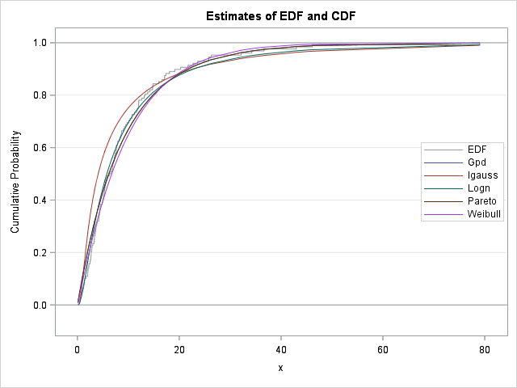
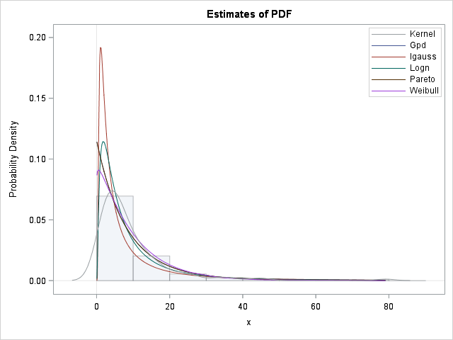
Model Assessment

Slide 11
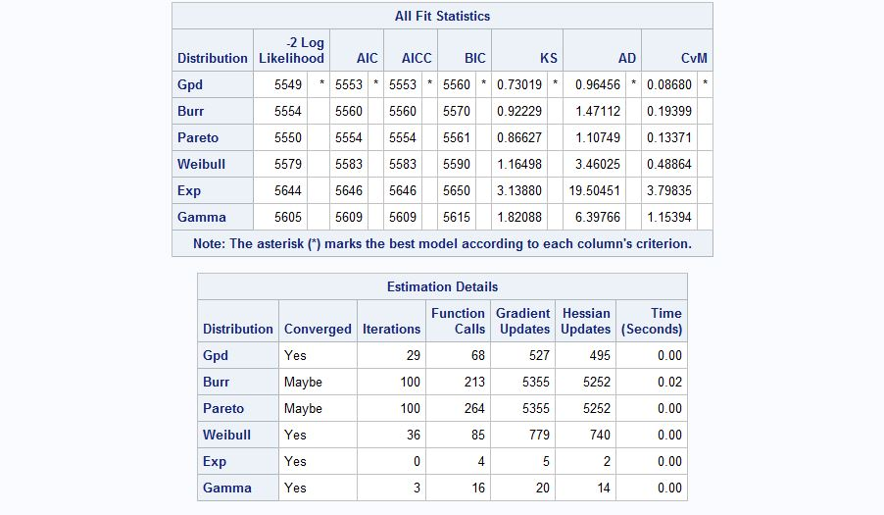
USA Blackout Data : Model Fit

Slide 12
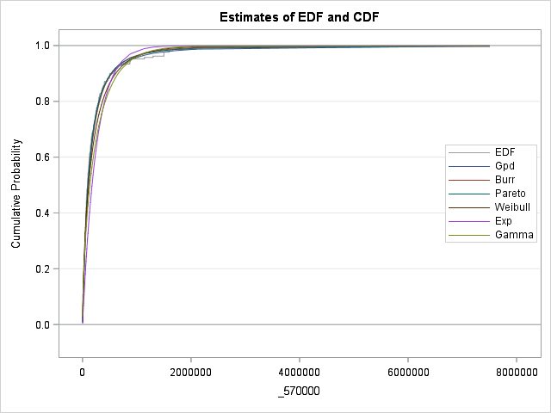
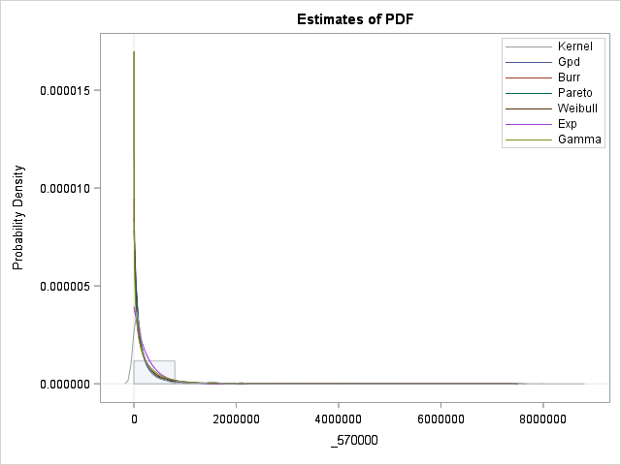
Model Assessment

Slide 13
Conclusion
Pareto and generalized version of Pareto distribution.
The method of maximum likelihood is suggested using PROC NLMIXED.
PROC SEVERITY is used for model fitting and model assessment.
Generalized Pareto distribution provides significantly better fit than the other distributions.

Slide 14
Future Research
Develop new probability distribution theory.
Develop their statistical property.
Real life Application with the new univariate distribution.
Apply various datasets and distributions to compare the best fit.

Slide 15
References
SAS/IML® software 14.2. SAS® Institute Inc. 2016, Cary, NC.
SAS/STAT® software 14.2. SAS® Institute Inc. 2016, Cary, NC.
Aban, I.B., Meerschaert, M.M. and Panorska, A.K. 2006. “Parameter estimation for the truncated Pareto distribution”, J. Am. Statist. Assoc. 101(473) pp. 270–277.
Akinsete, A., Famoye, F. and Lee, C. 2008. ‘’The beta-Pareto distribution.’’ Statistics, 42(6), 547-563.
Chen, J., Thorp, J. S. and Parashar, M. 2001, Analysis of electric power disturbance data. In 34th Hawaii International Conference on System Sciences, IEEE Computer Society.
Clauset, A, Shalizi, C.R. and Newman, M.E.J.2009. "Power-law distributions in empirical data" SIAM Review 51(4), 661-703. (arXiv:0706.1062).
Eugene, N., Lee, C. and Famoye, F. 2002. ‘’The beta-normal distribution and its applications,’’ Commun. Statist. Theory Meth., pp. 497–512.
Levy, M. and Levy, H. 2003. ‘’Investment talent and the Pareto wealth distribution: Theoretical and experimental analysis,’’ Rev. Econ. Statist. 85(3), pp. 709–725.
Lee, E. T. and Wang, J. 2003. ‘’Statistical methods for survival data analysis’’. volume 476. John Wiley & Sons.
Mahmoudi, E. 2011. “The beta generalized Pareto distribution with application to lifetime data.’’ Mathematics and Computers in Simulation, 81, 11, 2414–2430.
Newman, M.E.J. 2005. Power laws, Pareto distributions and Zipf’s law, Contemp. Phys. 46(5), pp. 323–351.

Slide 16
QUESTIONS?
Palash Sharma, M.S
psharma4@kumc.edu
John Keighley, Ph.D.
jkeighle@kumc.edu

Slide 17
Presenter: Palash Sharma
Institution: The University of Kansas Medical Center
Address: 3901 Rainbow Blvd, Kansas City, KS 66160
Phone: 775-203-7920
Email: psharma4@kumc.edu
Web: https:// palash63@github.io

